Slide 1
The
Medium Access Control (MAC)
Sublayer

Slide 2
The Channel Allocation Problem
Static Channel Allocation in LANs and MANs
Dynamic Channel Allocation in LANs and MANs

Slide 3
Static Channel Allocation
FDM – Frequency Division Multiplexing
T – Mean time delay
Arrival rate: λ frames/sec
Channel Capacity: C bps
Frame length: Drawn from exponential function –
1/μ bits/frame
T = 1 / (μC – λ)
FDM – one central queue
Single channel is divided into N independent sub-channels, each with capacity C/N bps.
T_{N} = 1 / [ μ (C/N) – (λ/N) ] = N / (μC – λ) = NT

Slide 4
Dynamic Channel Allocation in LANs and MANs
Station Model – N independent stations
Single Channel Assumption.
Collision Assumption – the event of collision of 2 frames can be detected by all stations
(a) Continuous Time.
(b) Slotted Time.
(a) Carrier Sense.
(b) No Carrier Sense.

Slide 5
Multiple Access Protocols
ALOHA
Carrier Sense Multiple Access Protocols
Collision-Free Protocols
Limited-Contention Protocols
Wavelength Division Multiple Access Protocols
Wireless LAN Protocols

Slide 6
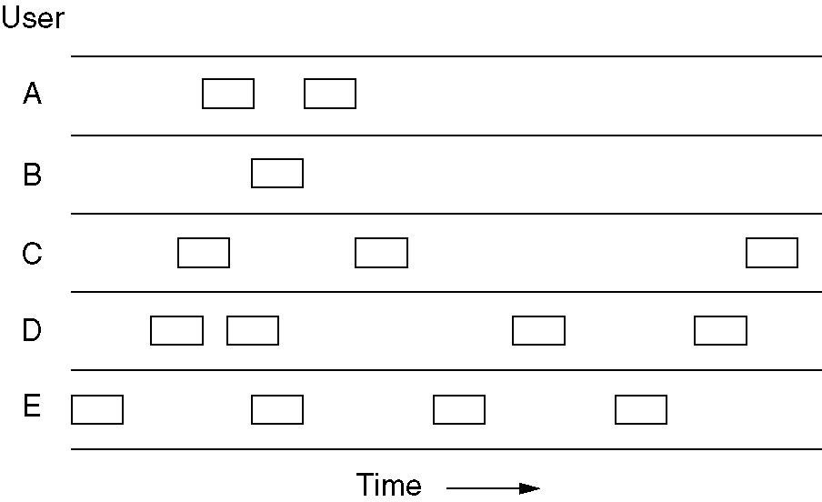
Pure ALOHA
In pure ALOHA, frames are transmitted at completely arbitrary times.

Slide 7
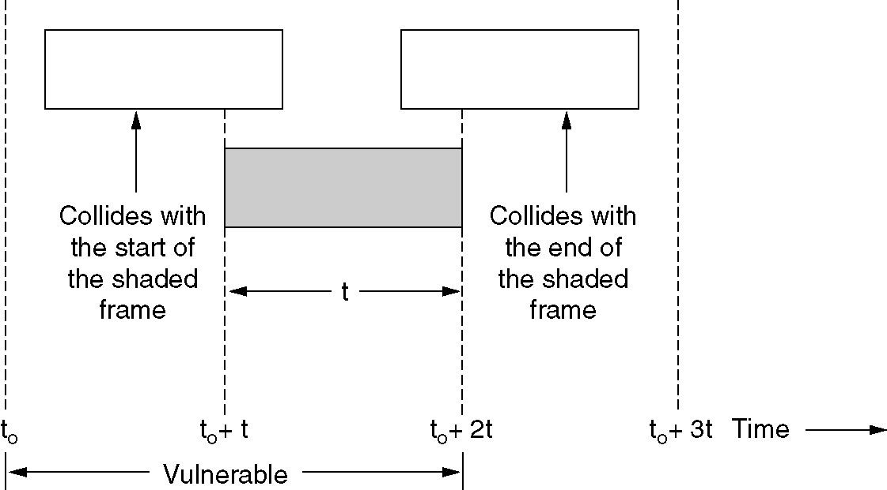
Pure ALOHA (2)
Vulnerable period for the shaded frame.

Slide 8
Static Channel Allocation
Assumption – Infinite Population
N new frames per mean frame time
N > 1 always collision
K transmission attempts per frame. So G frames per second.
G >= N
Throughput: S = G.P₀, where P₀ is the prob. that a frame does not suffer collision.
Pr[k] = (G^{k} . e^{-G})/ k!
S = G e^{-2G}

Slide 9
Slotted Aloha
Throughput: S = G.P₀, where P₀ is the prob. that a frame does not suffer collision.
Pr[k] = (G^{k} . e^{-G})/ k!
S = G e^{-G}

Slide 10
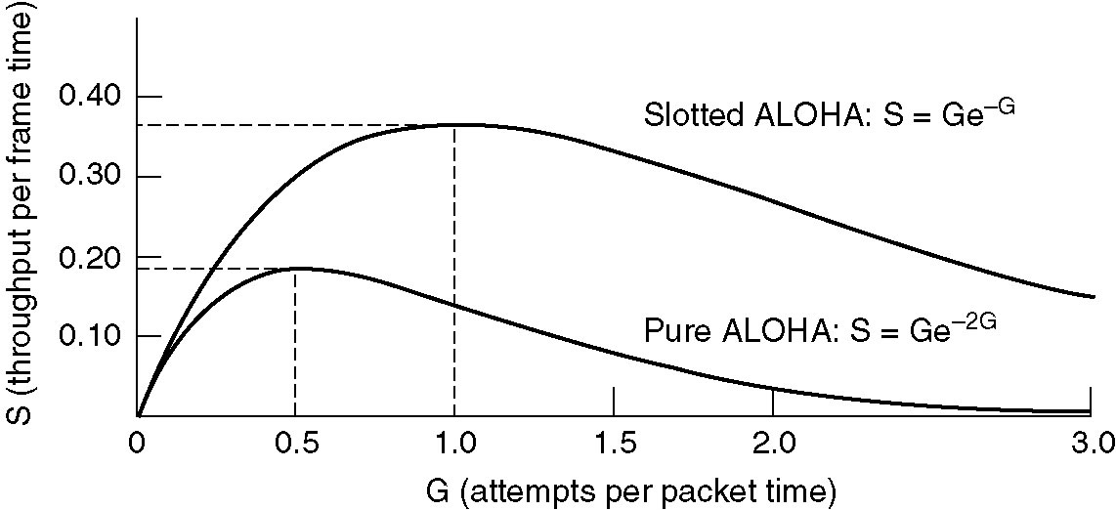
Pure ALOHA (3)
Throughput versus offered traffic for ALOHA systems.

Slide 11
Static Channel Allocation
Variation of collision with G
Probability that all other users are silent = (1 – e^{-G})
Probability that transmission requires exactly k attempts:
P_{k} = e^{-G} (1 – e^{-G})^{k-1}
Expected number of transmission: Σ k.P_{k} = e^{G}

Slide 12
Persistent and Nonpersistent CSMA
1-persistent CSMA (Carrier Sense Multiple Access).
If the channel is idle, the stations sends its data.
Otherwise, if the channel is busy, the station just waits until it becomes idle. Then the station transmits a frame.
If a collision occurs, the station waits a random amount of time and starts all over again.
The protocol is called 1-persistent because the station transmits with a probability of 1 when it finds the channel idle.

Slide 13
Persistent and Nonpersistent CSMA
1-persistent CSMA (Carrier Sense Multiple Access).
If the channel is idle, the stations sends its data.
Otherwise, if the channel is busy, the station just waits until it becomes idle. Then the station transmits a frame.
If a collision occurs, the station waits a random amount of time and starts all over again.
The protocol is called 1-persistent because the station transmits with a probability of 1 when it finds the channel idle.

Slide 14
Persistent and Nonpersistent CSMA
1-persistent CSMA (Carrier Sense Multiple Access).
If the channel is idle, the stations sends its data.
Otherwise, if the channel is busy, the station just waits until it becomes idle. Then the station transmits a frame.
If a collision occurs, the station waits a random amount of time and starts all over again.
The protocol is called 1-persistent because the station transmits with a probability of 1 when it finds the channel idle.

Slide 15
Persistent and Nonpersistent CSMA
Nonpersistent CSMA.
A station senses the channel when it wants to send a frame,
if no one else is sending, the station begins doing so itself.
However, if the channel is already in use, the station does not continually sense it for the purpose of seizing it immediately upon detecting the end of the previous transmission.
Instead, it waits a random period of time and then repeats the algorithm.
Consequently, this algorithm leads to better channel utilization but longer delays than 1-persistent
CSMA.

Slide 16
Persistent and Nonpersistent CSMA
p-persistent CSMA.
It applies to slotted channels and works as follows. When a station becomes ready to send, it senses the channel.
If it is idle, it transmits with a probability p. With a probability q = 1 − p, it defers until the next slot.

Slide 17
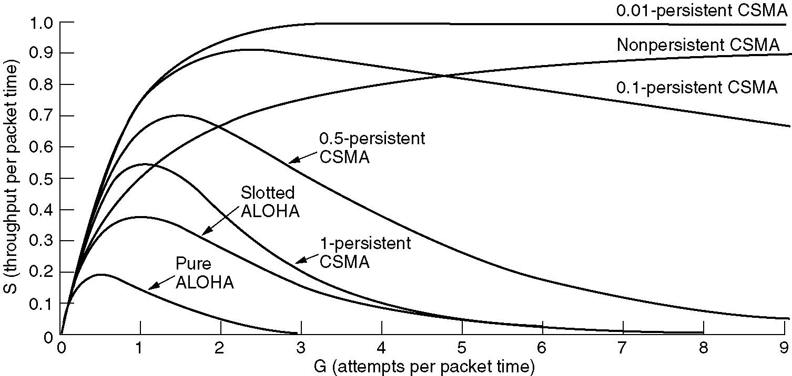
Persistent and Nonpersistent CSMA
Comparison of the channel utilization versus load for various random access protocols.

Slide 18
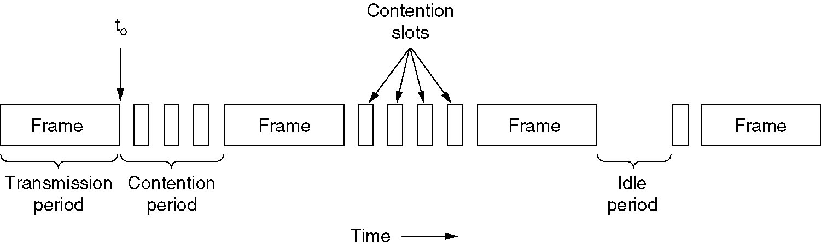
CSMA with Collision Detection
CSMA/CD can be in one of three states: contention, transmission, or idle.

Slide 19
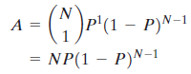
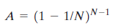
CSMA/CD Performance
A = probability that exactly one station attempts a transmission in a slot and therefore acquires the medium = binomial probability that any one station attempts to transmit and the others don’t
The function takes on a maximum over P when P = 1/N.
Maximum throughput will be achieved if the probability of successful seizure of the medium is maximized.
During periods of heavy usage, a station should restrain its offered load to 1/N.

Slide 20

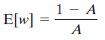


CSMA/CD Performance
The summation converges to:
Max. utilization = length of a transmission interval as a proportion of a cycle consisting of a transmission and a contention interval.

Slide 21
Ethernet (802.3)
Ethernet Cabling
Manchester Encoding
The Ethernet MAC Sublayer Protocol
The Binary Exponential Backoff Algorithm
Ethernet Performance
Switched Ethernet
Fast Ethernet
Gigabit Ethernet
IEEE 802.2: Logical Link Control
Retrospective on Ethernet

Slide 22
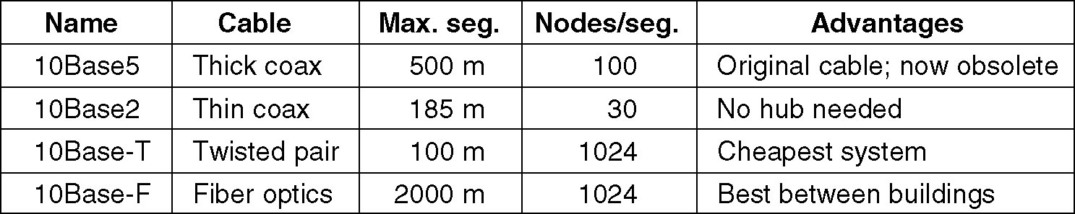
Ethernet Cabling
The most common kinds of Ethernet cabling.

Slide 23
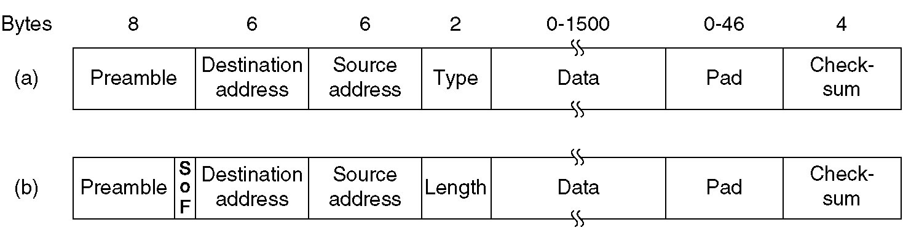
Ethernet MAC Sublayer Protocol
Frame formats. (a) DIX Ethernet, (b) IEEE 802.3.

Slide 24
Preamble of 8 bytes,
each containing the bit pattern 10101010 (with the exception of the last byte, in which the last 2 bits are set to 11). This last byte is called the Start of Frame delimiter for 802.3.
Destination address – 1 means multicast 1111 – broadcast
Source Address – Mac Address
To do this, the first 3 bytes of the address field are used for an OUI (Organizationally Unique Identifier). indicate a manufacturer.
manufacturer assigns the last 3 bytes of the address

Slide 25
Length and Protocol
< 1536 is length and higher is Type a type code of 0x0800 means that the data contains an IPv4 packet
Least length = 64 Byte

Slide 26
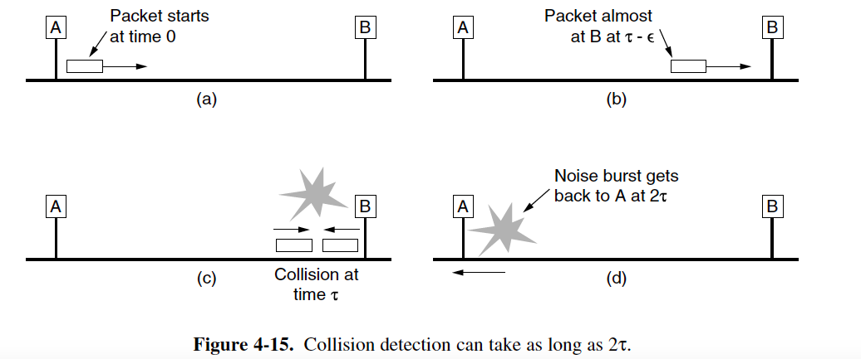
For a 10-Mbps LAN with a maximum
length of 2500 meters and four repeaters (from the 802.3 specification), the
round-trip time (including time to propagate through the four repeaters) has been determined to be nearly 50 μsec in the worst case
Therefore, the shortest allowed frame must take at least this long to transmit. At 10 Mbps, a bit takes 100 nsec, so 500 bits is the smallest frame that is guaranteed to work. To add some margin of safety, this number was rounded up to 512 bits or 64 bytes.

Slide 27
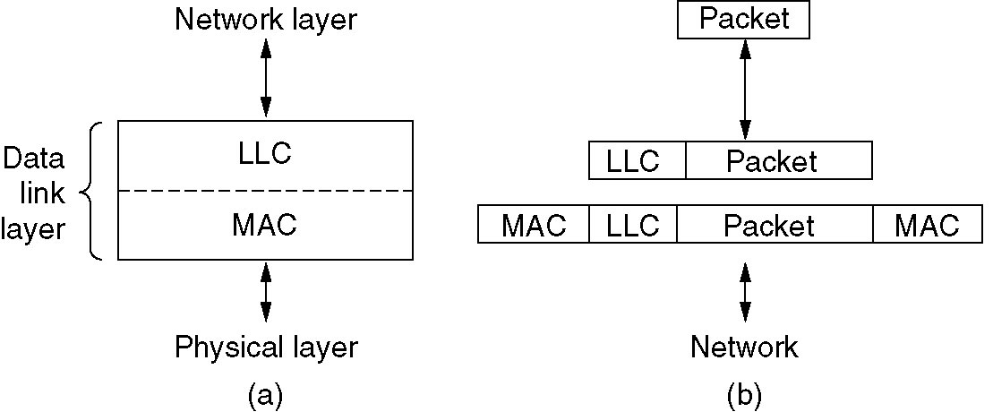
IEEE 802.2: Logical Link Control
(a) Position of LLC. (b) Protocol formats.

Slide 28
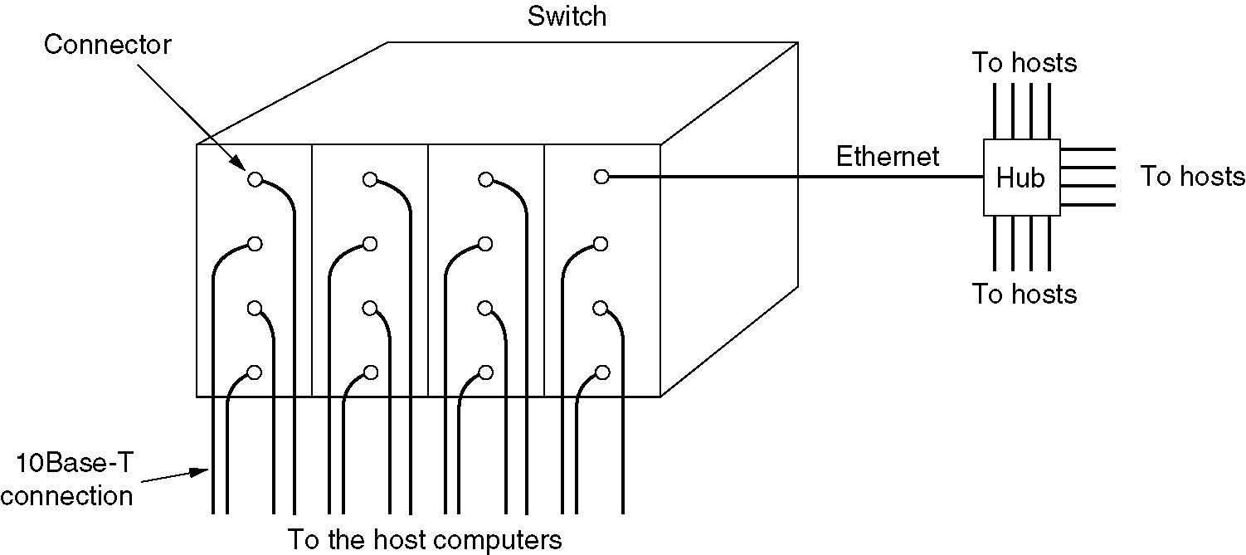
Switched Ethernet
A simple example of switched Ethernet.

Slide 29
A switch improves performance over a hub in two ways.
Since there are no collisions, the capacity is used more efficiently.
With a switch multiple frames can be sent simultaneously (by different stations).
These frames will reach the switch ports and travel over the switch’s backplane to be output on the proper ports.
Two frames might be sent to the same output port at the same time,
the switch must have buffering so that it
can temporarily queue an input frame until it can be transmitted to the output port.

Slide 30
Wireless LANs
The 802.11 Protocol Stack
The 802.11 Physical Layer
The 802.11 MAC Sublayer Protocol
The 802.11 Frame Structure
Services

Slide 31
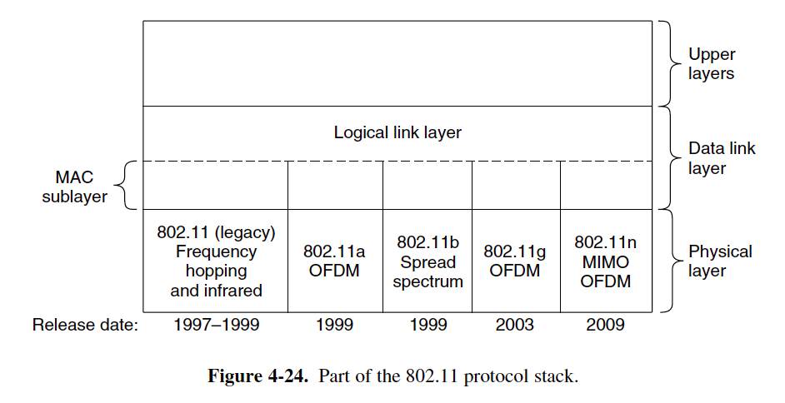
The 802.11 Protocol Stack
54 MbPs, 11 MbPs, 54 MbPs, .

Slide 32
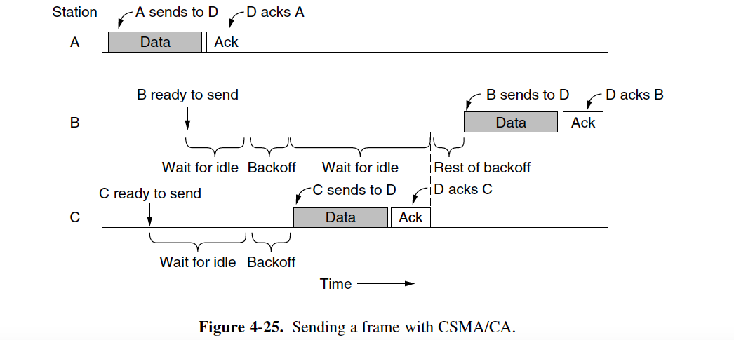
CSMA/CA
Exponential Back-off
Collisions are expensive, as the entire frame is transmitted even if one occurs.
Second, acknowledgements are used to infer collisions because collisions cannot be detected
Notes:
Picture Needed

Slide 33

END
Collisions are expensive, as the entire frame is transmitted even if one occurs.
Second, acknowledgements are used to infer collisions because collisions cannot be detected

Slide 34
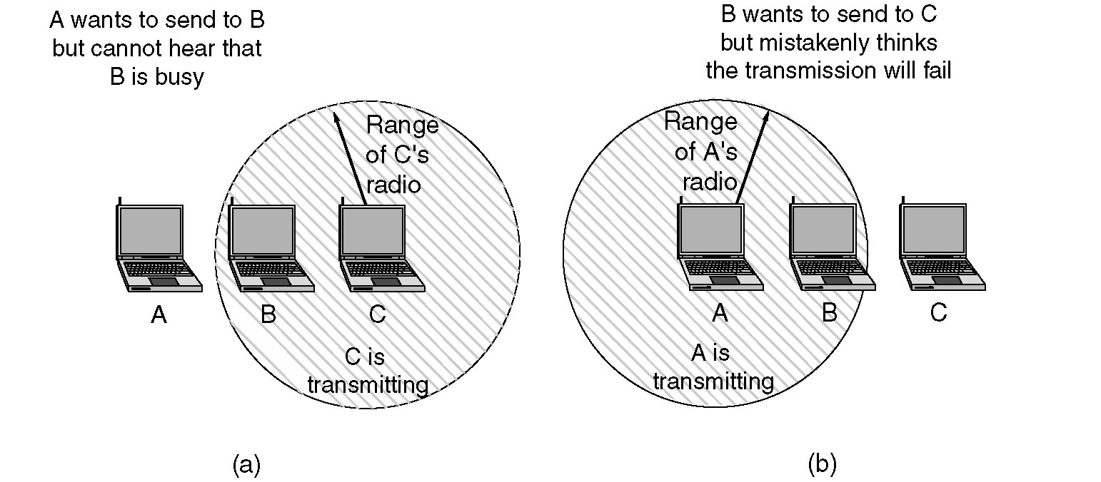
The 802.11 MAC Sublayer Protocol
(a) The hidden station problem.
(b) The exposed station problem. (A sending to B)

Slide 35
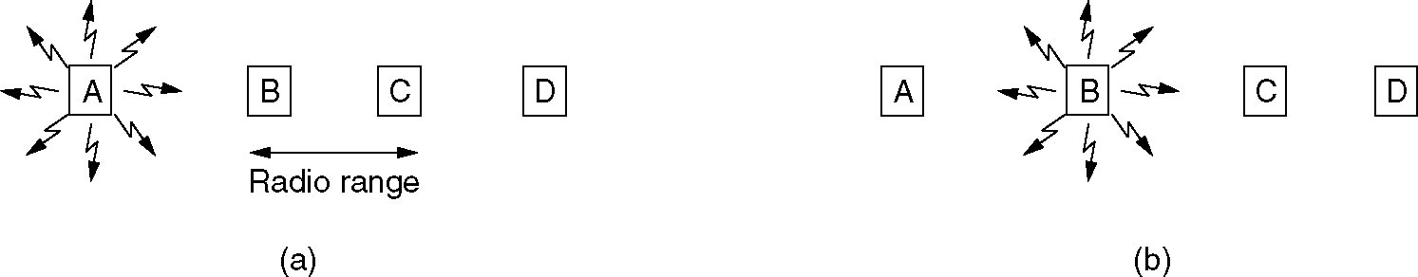
Wireless LAN Protocols
A wireless LAN. (a) A transmitting. (b) B transmitting.
Hidden Terminal and exposed terminal problem

Slide 36
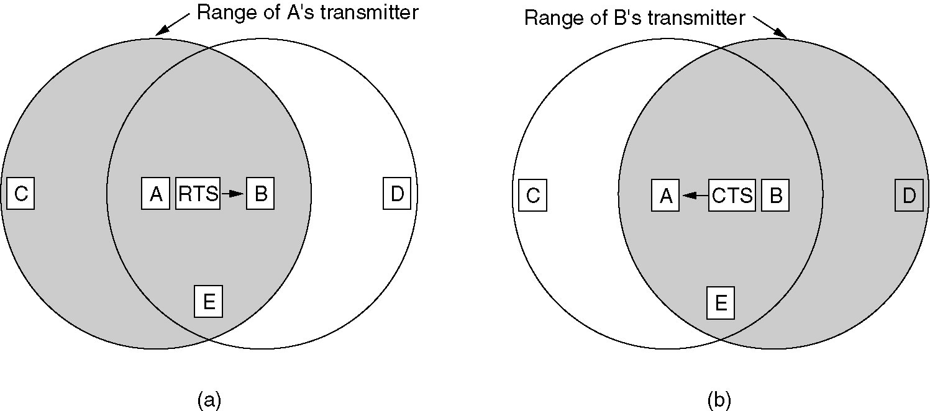
Wireless LAN Protocols (2)
The Multiple Access with Collision Avoidance (MACA) protocol.
(a) A sending an RTS to B.
(b) B responding with a CTS to A.

